Slide 1
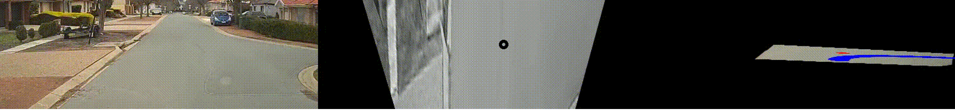
An interpretable system for single camera autonomous vehicle navigation localisation

Slide 2
Focus
Single camera navigation localisation
Route feature detection and tracking
Driving line development
Modular with defined input/outputs
Swap out individual module implementations
Human interpretable
Explainable modules and understandable input/outputs
Designed to be an input to a controller

Slide 3
Scope
Intersection detection from still image
No other vehicles
Detectable road surface
Extension
Driving line confirmation and intersection tracking

Slide 4





Mask Matching
$$M$$
$$I_{original}$$
$$I_{masked}$$
Hadamard product
$$I_{masked}=M∘I_{original}$$

Slide 5
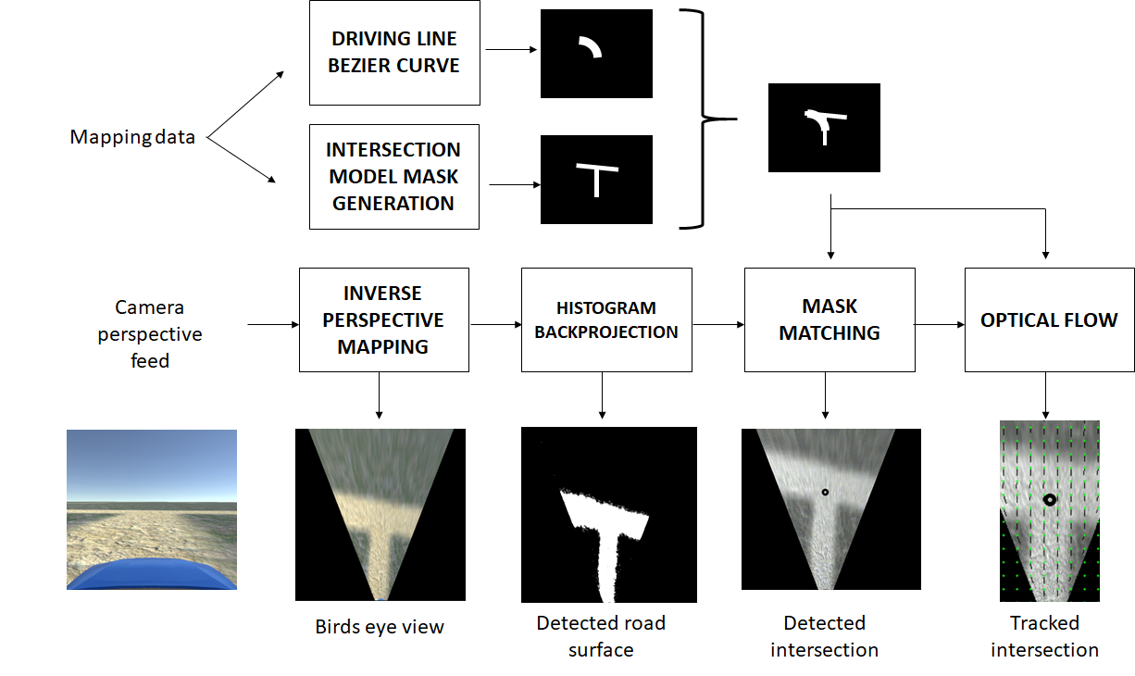

Slide 7
IPM

Slide 8
IPM

Slide 9
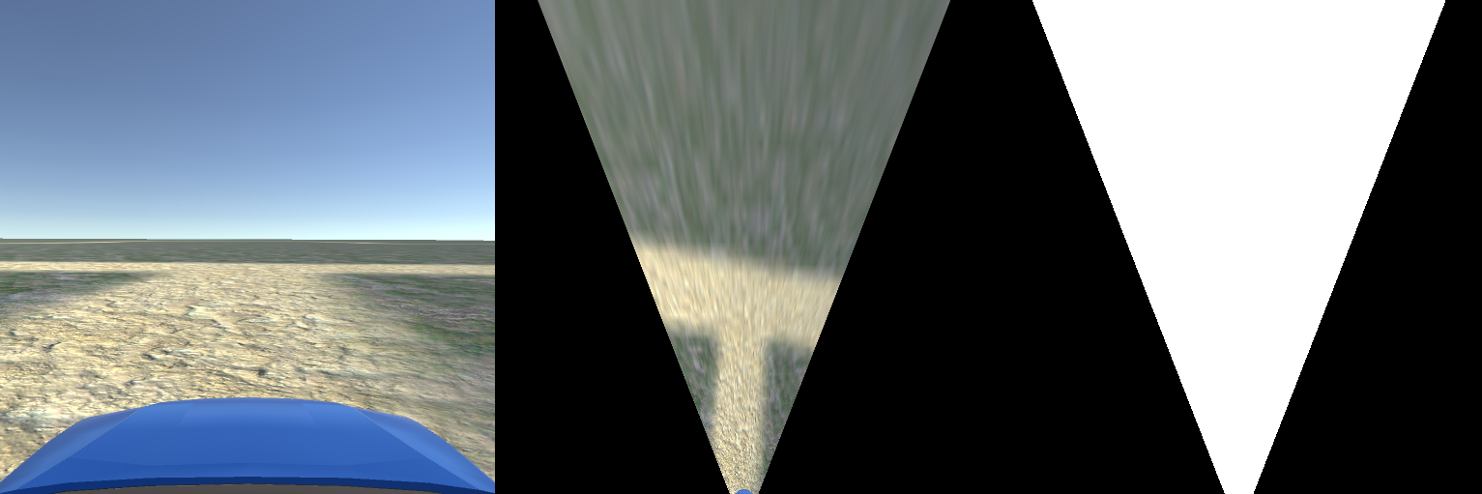
IPM
5m
5m
100px

Slide 12
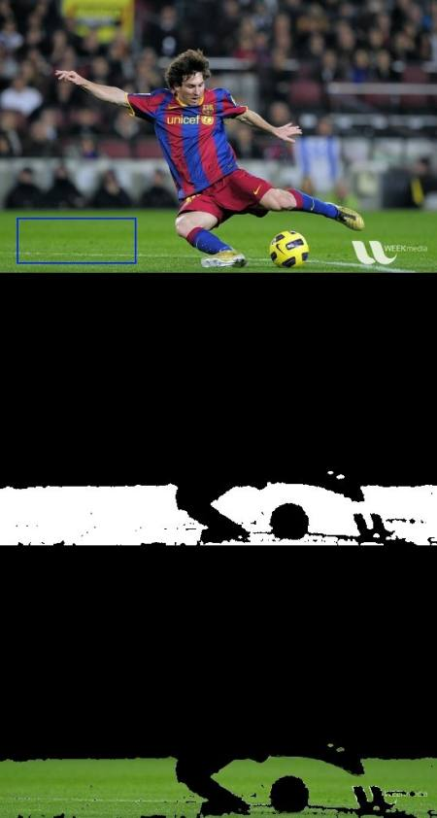
Histogram Backprojection
https://docs.opencv.org/master/dc/df6/tutorial_py_histogram_backprojection.html

Slide 13
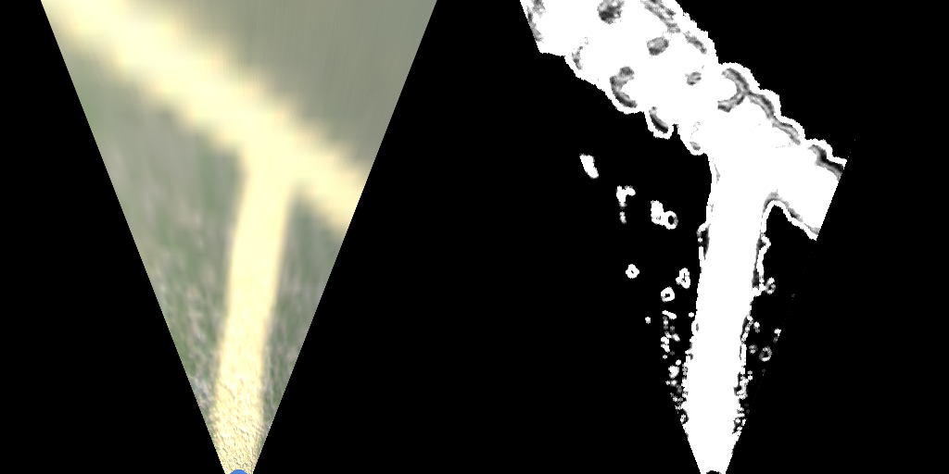
Histogram Backprojection

Slide 16
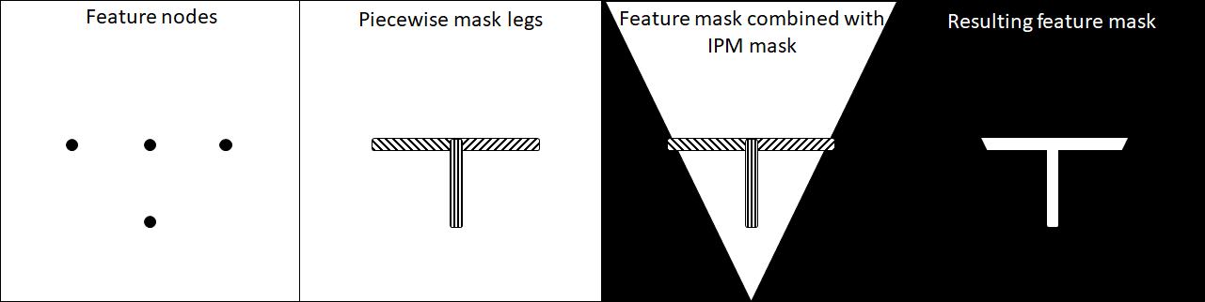
Feature mask generation

Slide 19
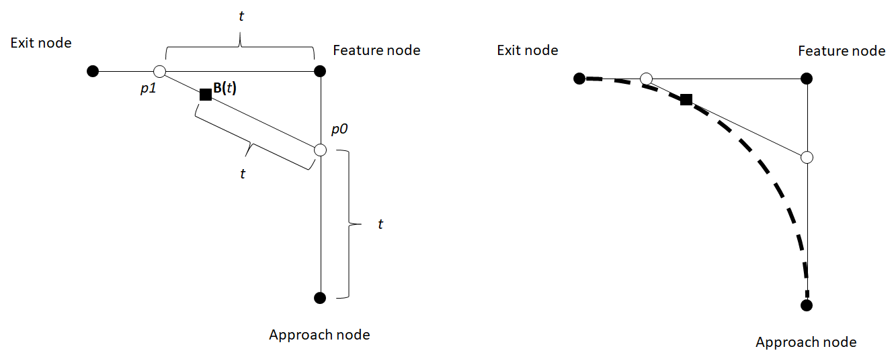
Driving line generation

Slide 23
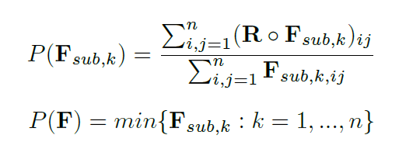


Mask Matching
Detected road
Feature mask

Slide 24
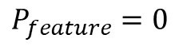
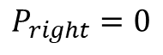
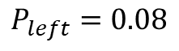
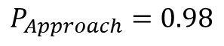
Mask Matching
$$P_{Approach}=0.98$$
$$P_{left}=0.08$$
$$P_{feature}=0$$
$$P_{right}=0$$

Slide 25

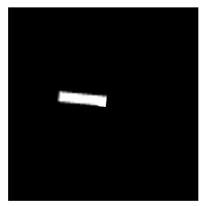
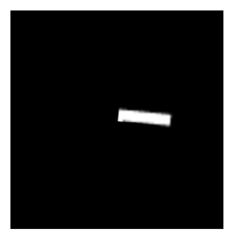
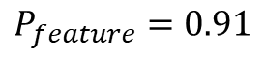
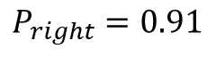
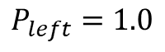
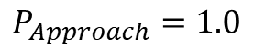
Mask Matching
$$P_{Approach}=1.0$$
$$P_{left}=1.0$$
$$P_{feature}=0.91$$
$$P_{right}=0.91$$

Slide 28
Optical flow
(2,3)

Slide 29
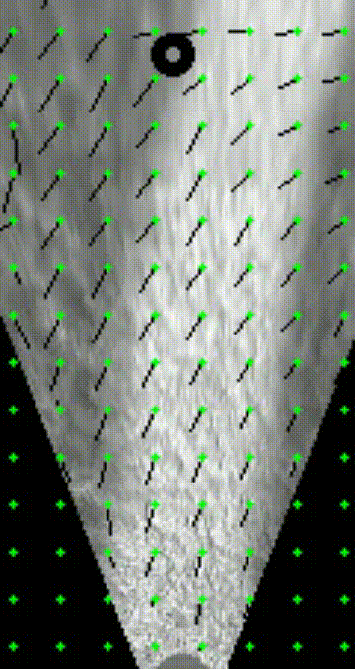
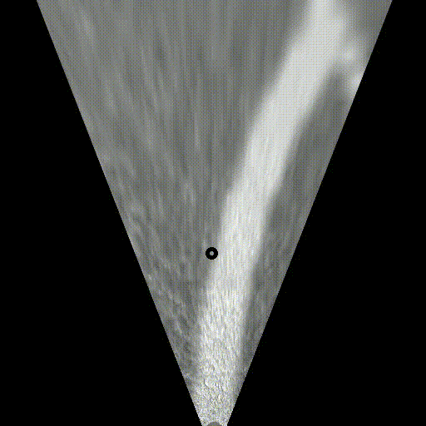
Optical flow
Gunnar Farnebäck optical flow algorithm:
“Two-Frame Motion Estimation Based on Polynomial Expansion”

Slide 31
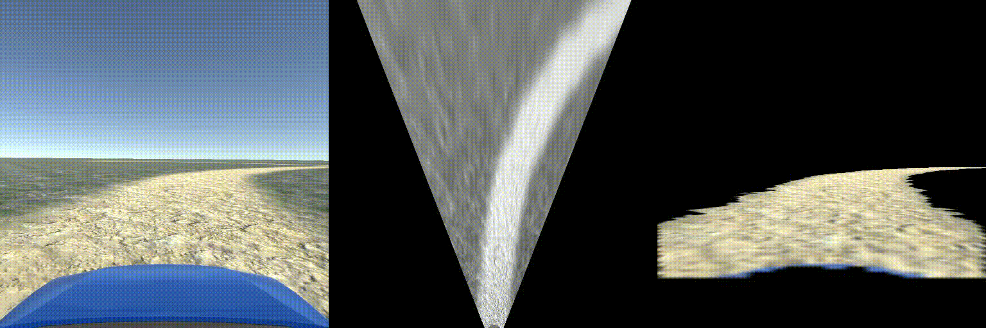
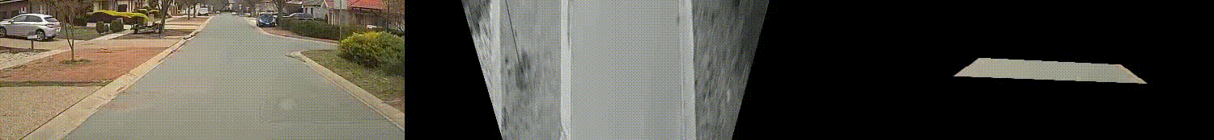

Slide 34
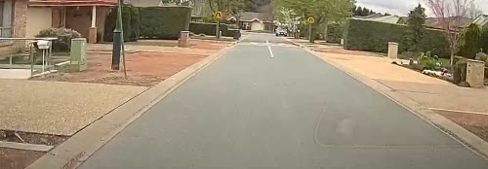
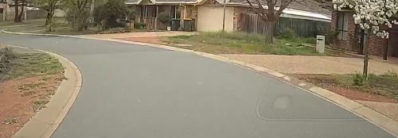
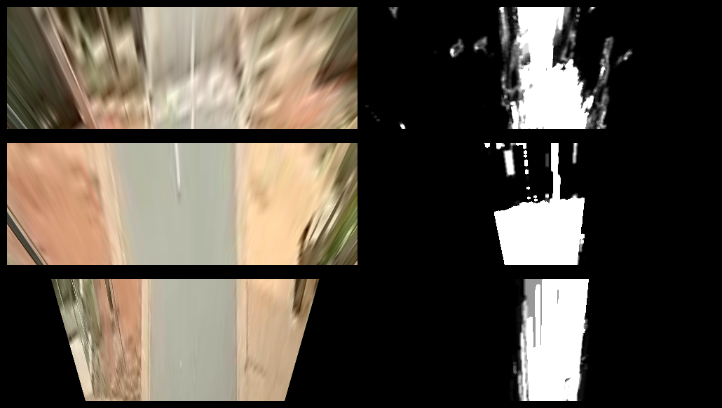
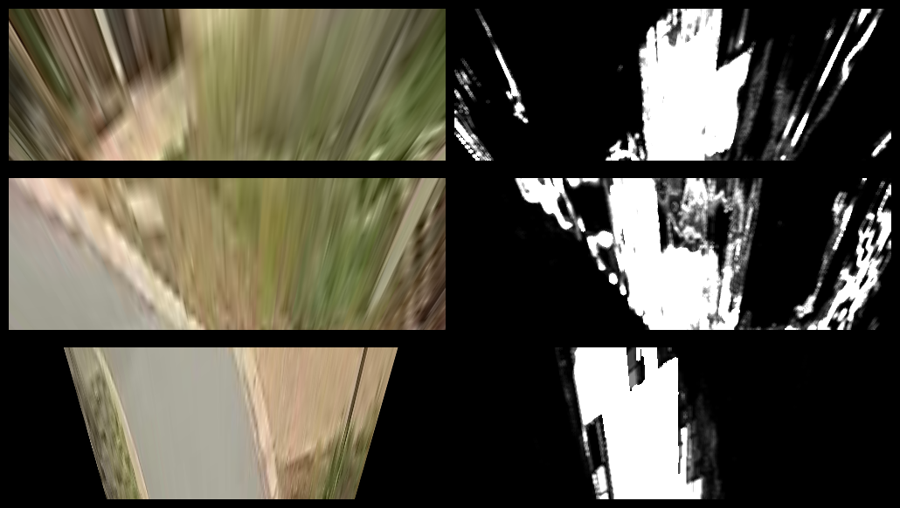





Slide 35
Percent Correct | Percent Incorrect
67.186% | 1.148%
43.761% | 0.391%
74.868% | 0.486%

Slide 36
Percent Correct | Percent Incorrect
0% | 20.558%
0% | 30.798%
75.261% | 0.818%

Slide 37
Histogram Backprojection

Slide 38
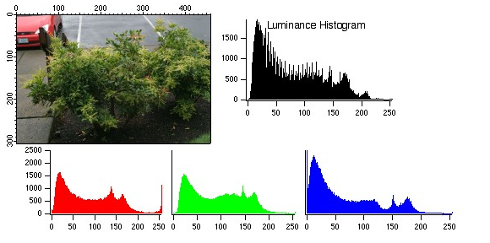
Histogram Backprojection
From: https://www.wavemetrics.com/products/igorpro/imageprocessing/imagetransforms/histmodification

Slide 39
Histogram Backprojection
https://docs.opencv.org/master/dc/df6/tutorial_py_histogram_backprojection.html

Slide 41
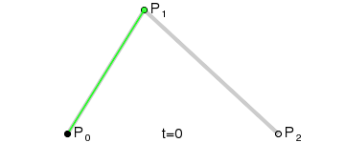
From: https://en.wikipedia.org/wiki/B%C3%A9zier_curve

Slide 42
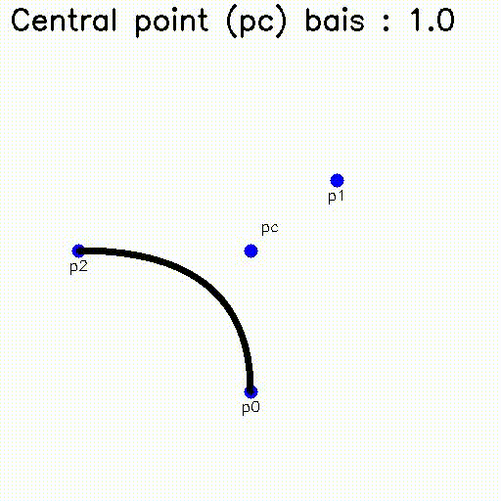

Slide 43
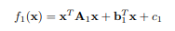
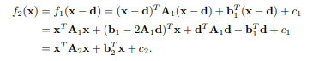
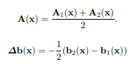
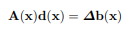
Optical flow
Gunnar Farnebäck optical flow algorithm:
“Two-Frame Motion Estimation Based on Polynomial Expansion”

Slide 44
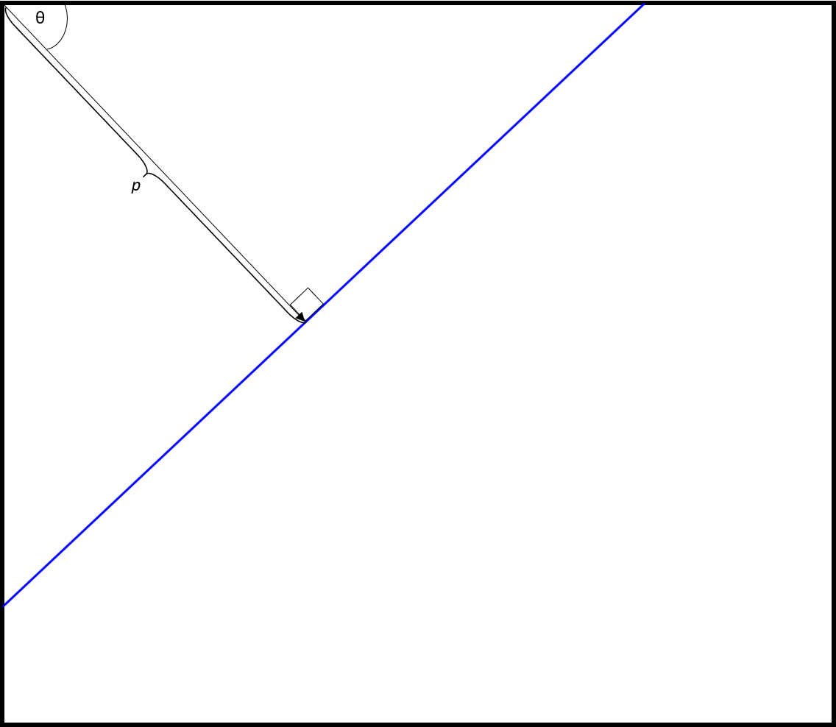
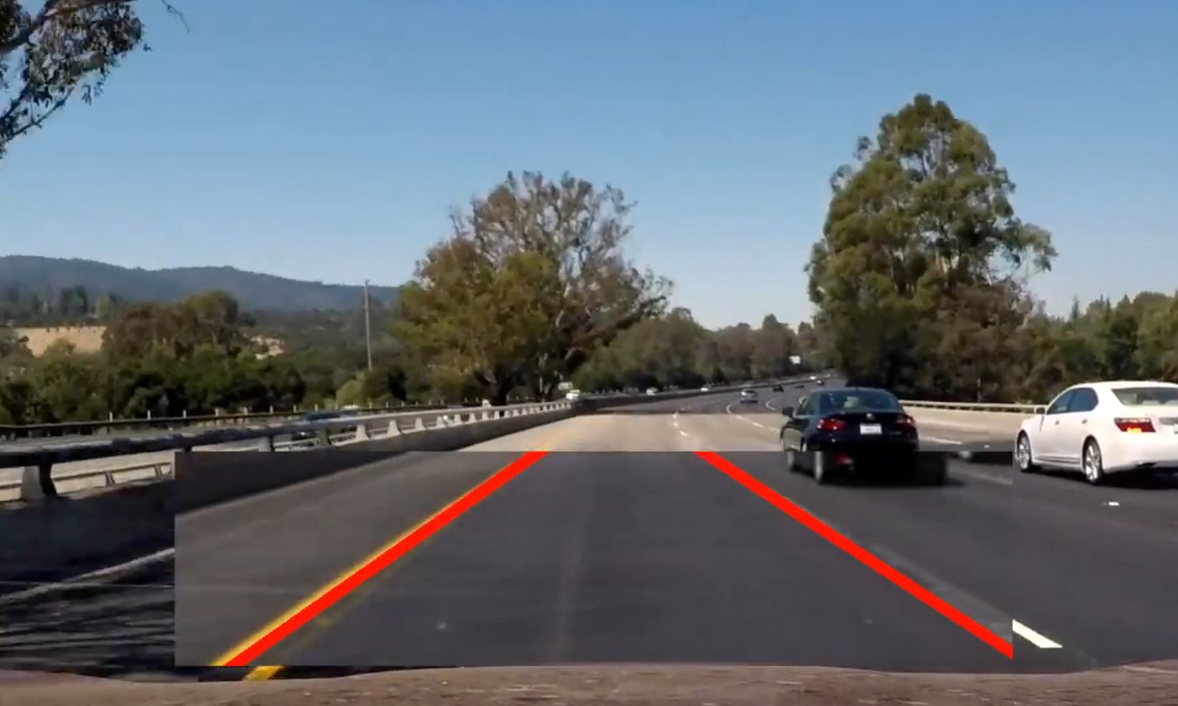
Edge detection with Hough Transform

Slide 45
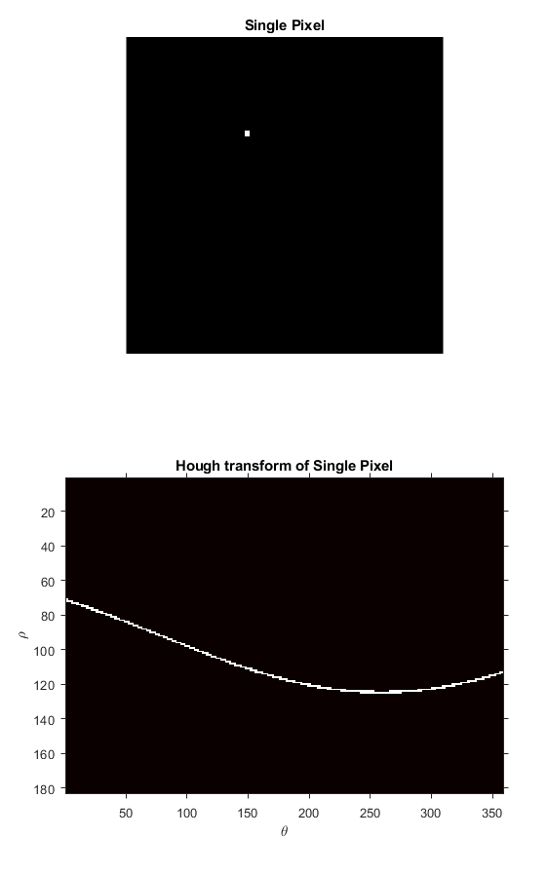
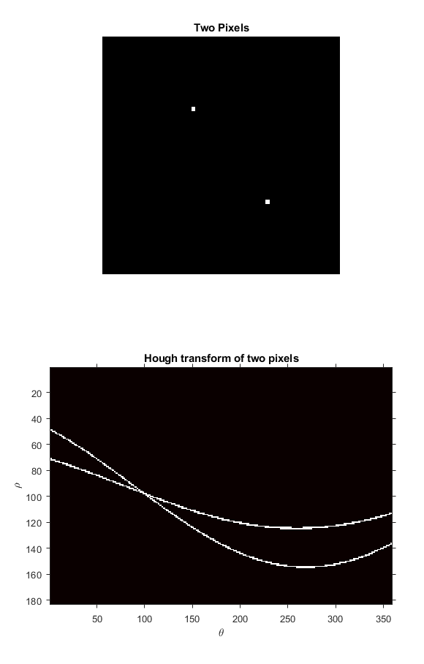

Slide 46
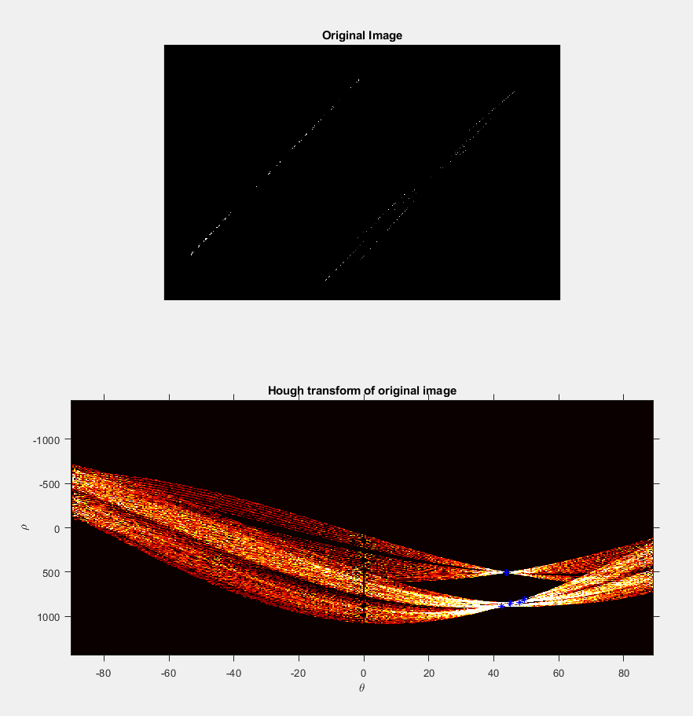

Slide 47
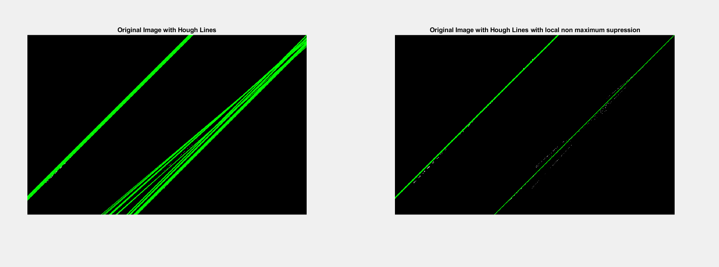

Slide 48
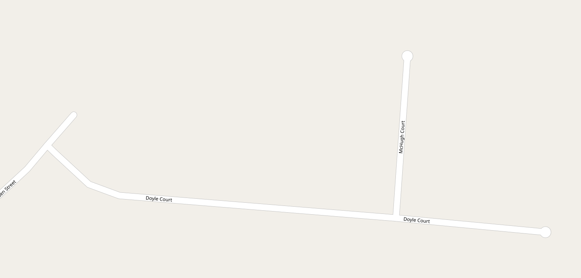
Mapping data (OSM, Google maps)

Slide 49
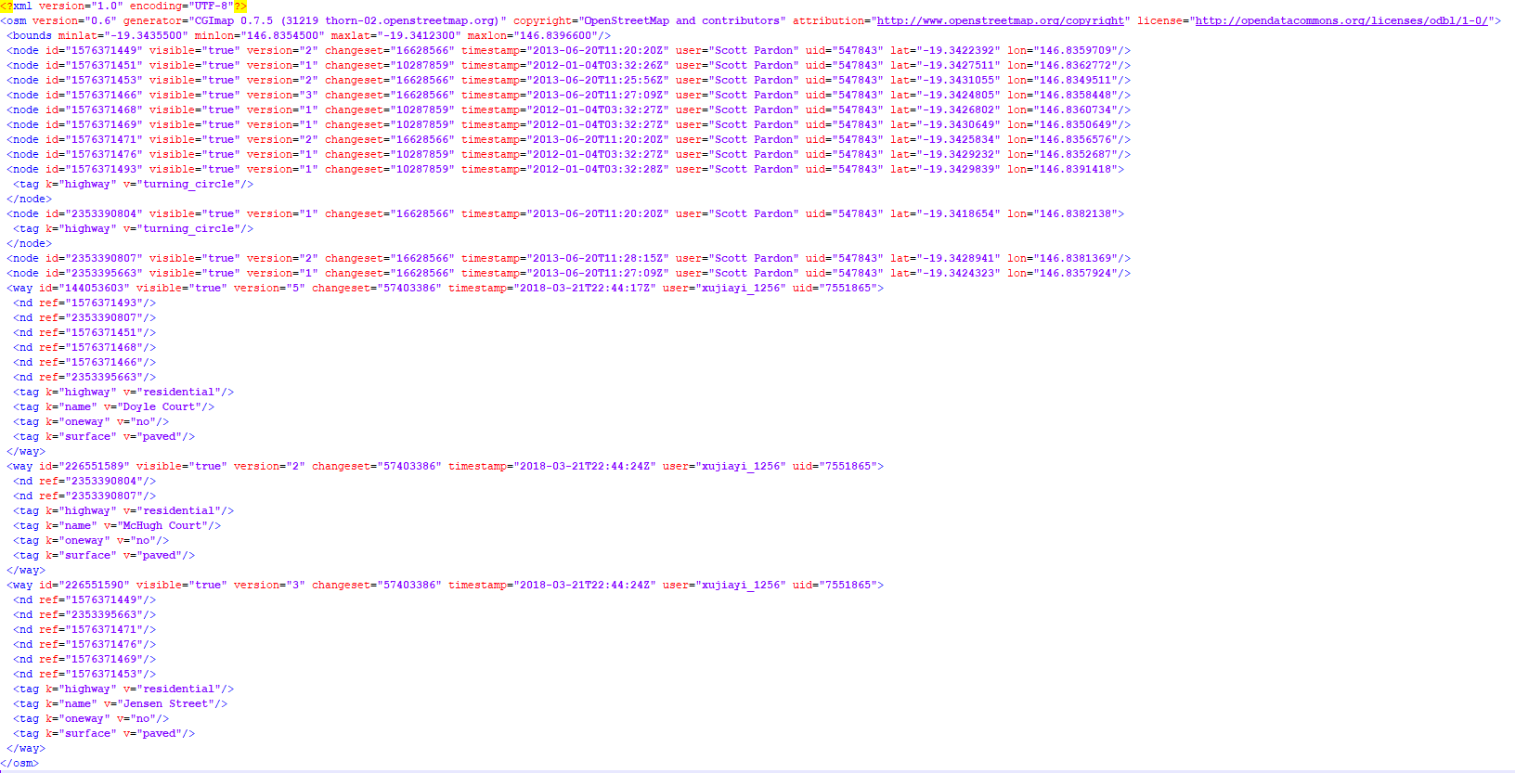
Mapping data (OSM, Google maps)

Slide 50
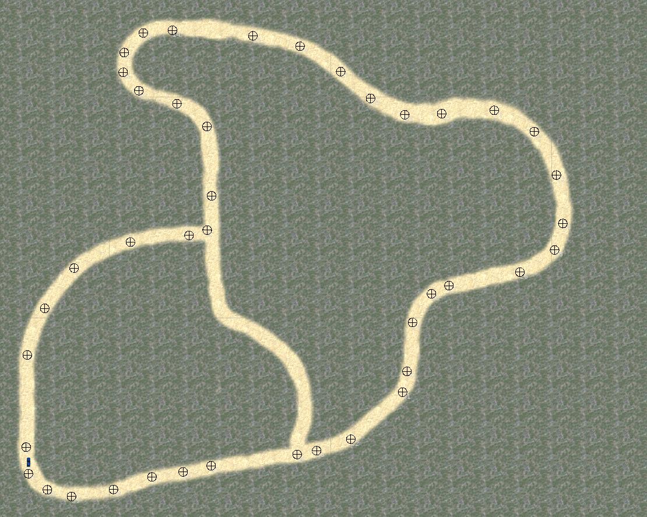
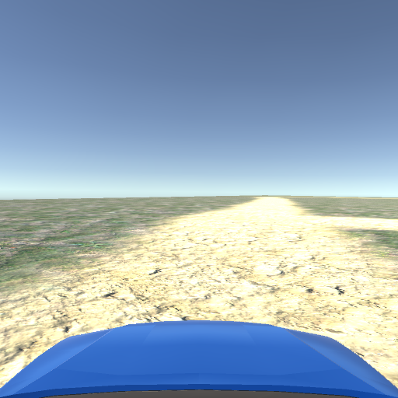
Simulation

